Slide 1
PAC LEARNING

Slide 2
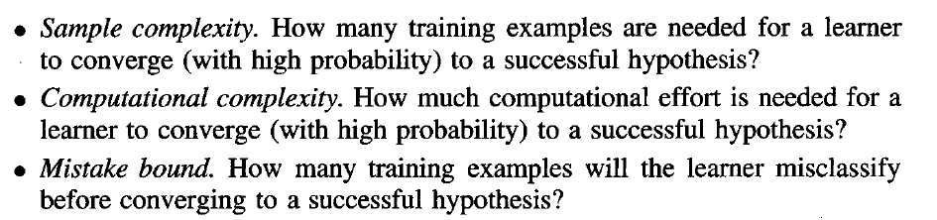
For the most part, we will focus not on individual learning algorithms, but rather on broad classes of learning algorithms characterized by the hypothesis spaces they consider, the presentation of training examples, etc. Our goal is to answer questions such as:

Slide 3
PROBABLY LEARNING AN APPROXIMATELY CORRECT HYPOTHESIS
we consider a particular setting for the learning problem, called the probably approximately correct (PAC) learning model.
Then consider the questions of how many training examples and how much computation are required in order to learn various classes of target functions within this PAC model.
For the sake of simplicity, we restrict the discussion to the case of learning boolean valued concepts from noise-free training data.

Slide 4
The Problem Setting
As in earlier chapters, let X refer to the set of all possible instances over which target functions may be defined.
    For example, X might represent the set of all people, each described by the attributes age (e.g., young or old) and height (short or tall).
Let C refer to some set of target concepts that our learner might be called upon to learn. Each target concept c in C corresponds to some subset of X, or equivalently to some boolean-valued function c : X → {0, 1}.
    For example, one target concept c in C might be the concept "people who are skiers." If x is a positive example of c, then we will write c(x) = 1; if x is a negative example, c(x) = 0.

Slide 5
We assume instances are generated at random from X according to some probability distribution D.
The learner L considers some set H of possible hypotheses when attempting to learn the target concept.
    For example, H might be the set of all hypotheses describable by conjunctions of the attributes age and height. After observing a sequence of training examples of the target concept c, L must output some hypothesis h from H, which is its estimate of c.
Within this setting, we are interested in characterizing the performance of various learners L using various hypothesis spaces H, when learning individual target concepts drawn from various classes C.

Slide 6
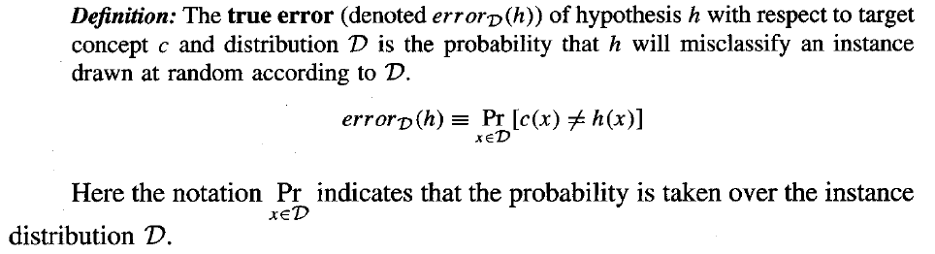
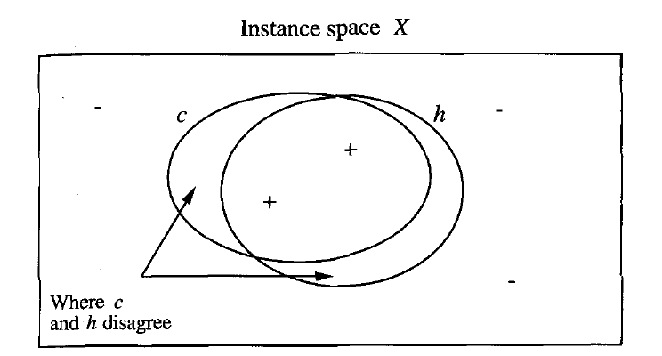
Error of a Hypothesis

Slide 7
PAC Learnability
Our aim is to characterize classes of target concepts that can be reliably learned from a reasonable number of randomly drawn training examples and a reasonable amount of computation.
What kinds of statements about learnability should we guess hold true?
    We might try to characterize the number of training examples needed to learn a hypothesis h for which errorD(h) = 0.
for two reasons.
  First, unless we provide training examples corresponding to every possible instance in X (an unrealistic assumption), there may be multiple hypotheses consistent with the provided training examples, and the learner cannot be certain to pick the one corresponding to the target concept.
  Second, given that the training examples are drawn randomly there will always be some nonzero probability that the training examples encountered by the learner will be misleading.

Slide 8
To accommodate these two difficulties, we weaken our demands on the learner in two ways.
  First, we will not require that the learner output a zero error hypothesis-we will require only that its error be bounded by some constant, є, that can be made arbitrarily small.
  Second, we will not require that the learner succeed for every sequence of randomly drawn training examples-we will require only that its probability of failure be bounded by some constant, δ, that can be made arbitrarily small.
In short, we require only that the learner probably learn a hypothesis that is approximately correct-hence the term probably approximately correct learning, or PAC learning for short.

Slide 9
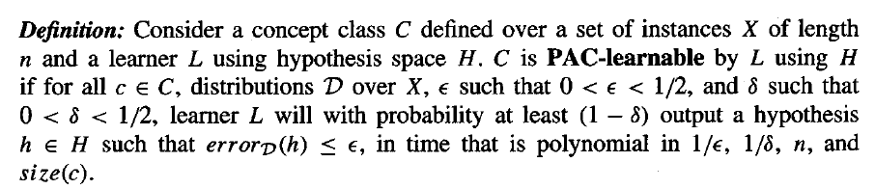
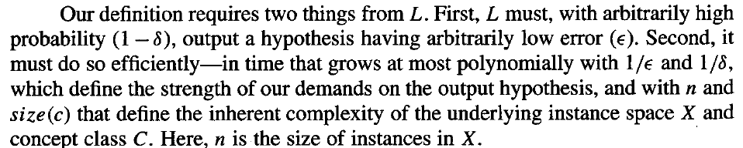

Slide 10
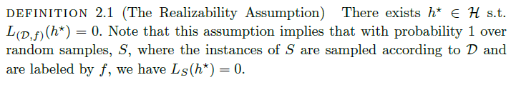

Slide 11
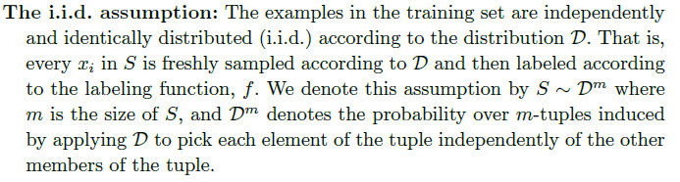

Slide 12

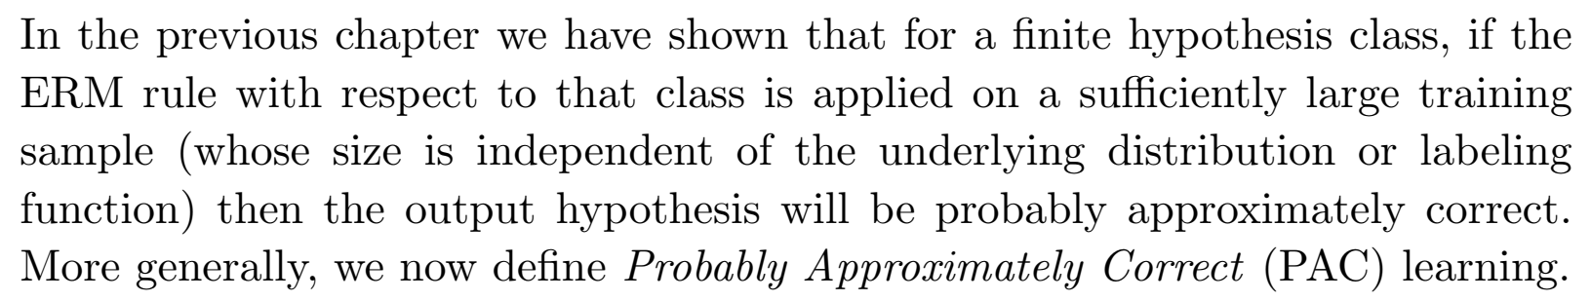

Slide 13
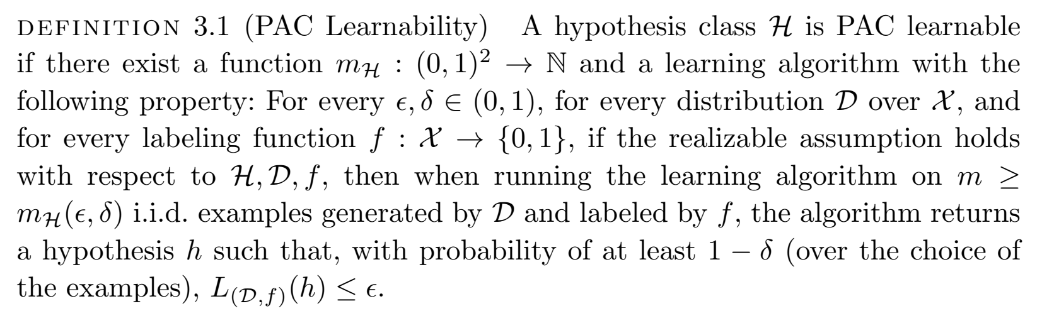
Definition
Notes:
Realizable Case

Slide 14
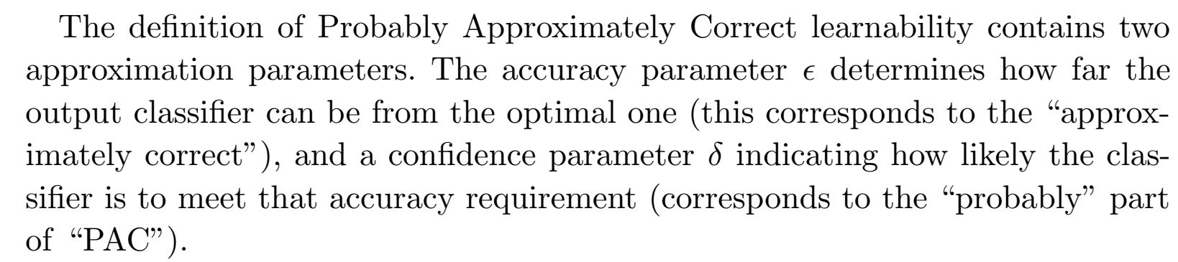
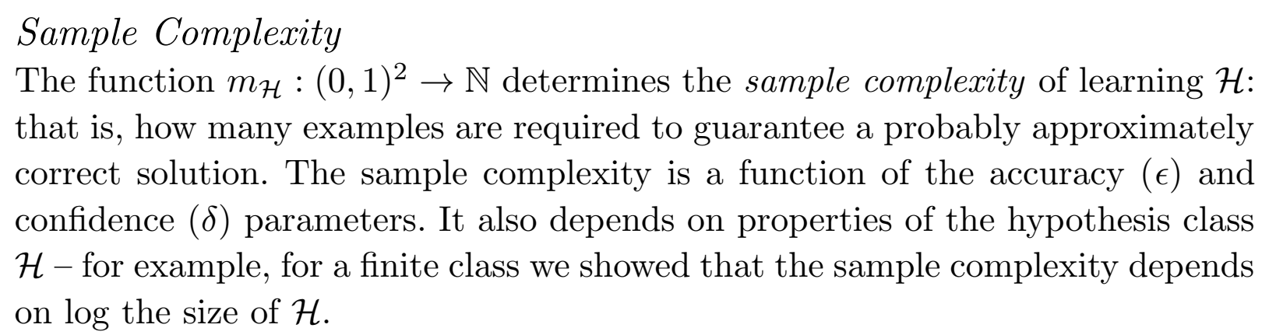

Slide 15
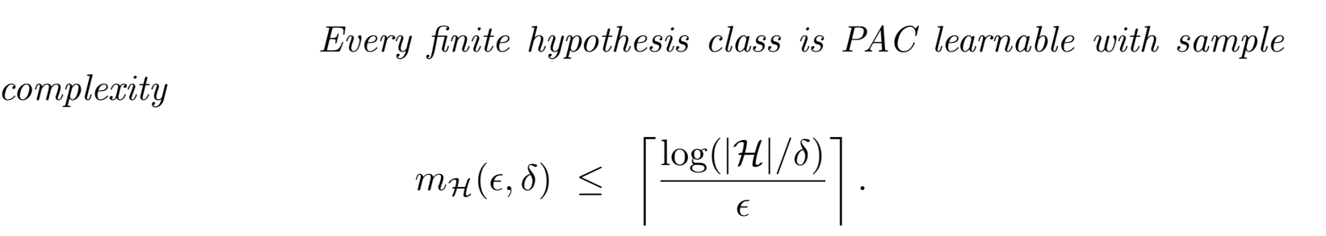

Slide 16
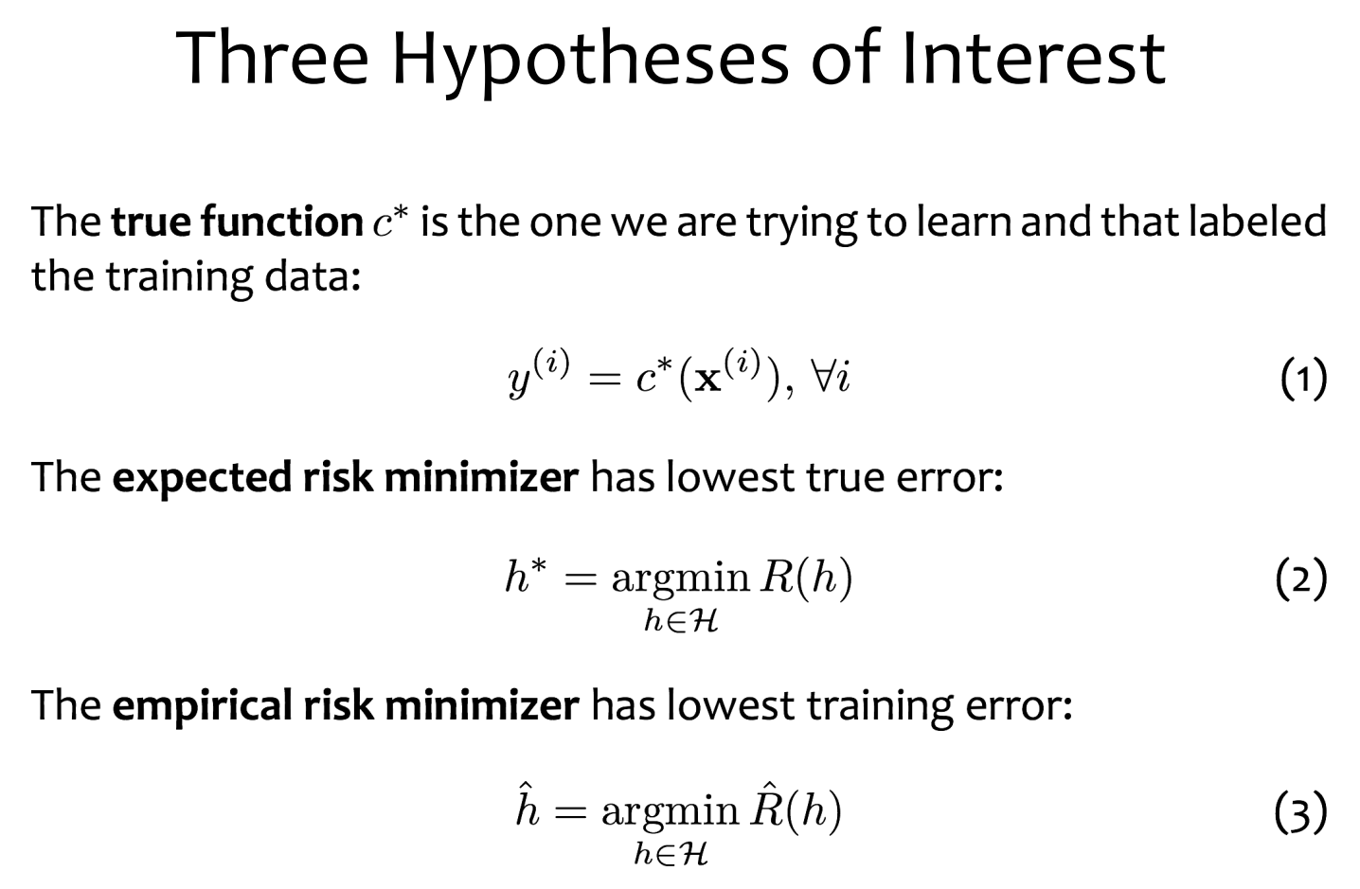

Slide 17
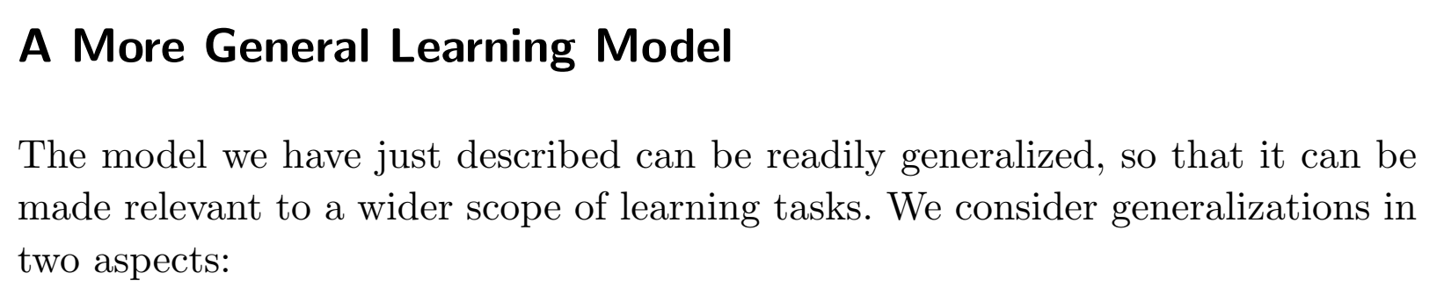
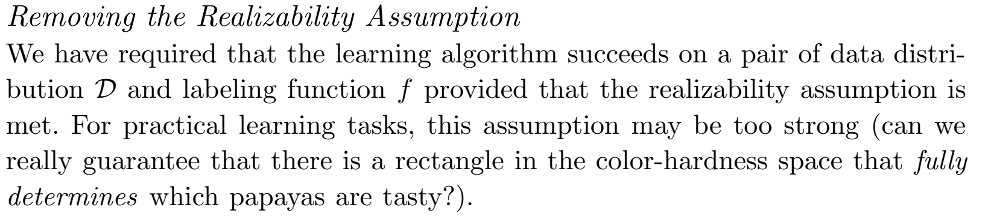

Slide 18
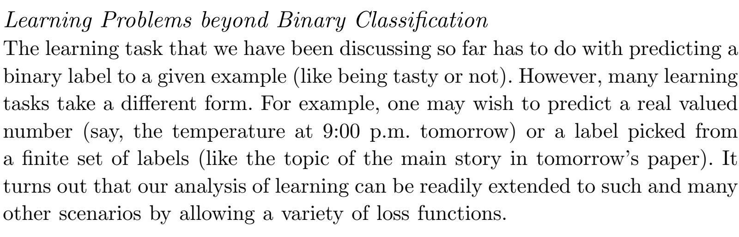

Slide 19
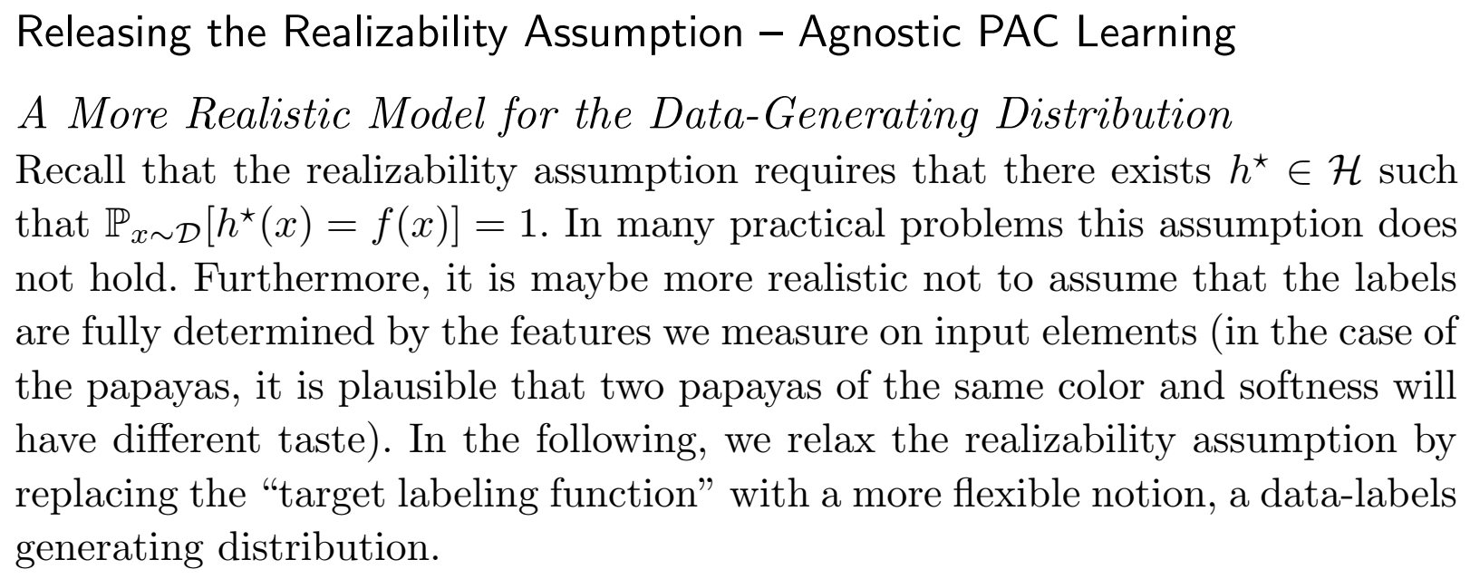

Slide 20
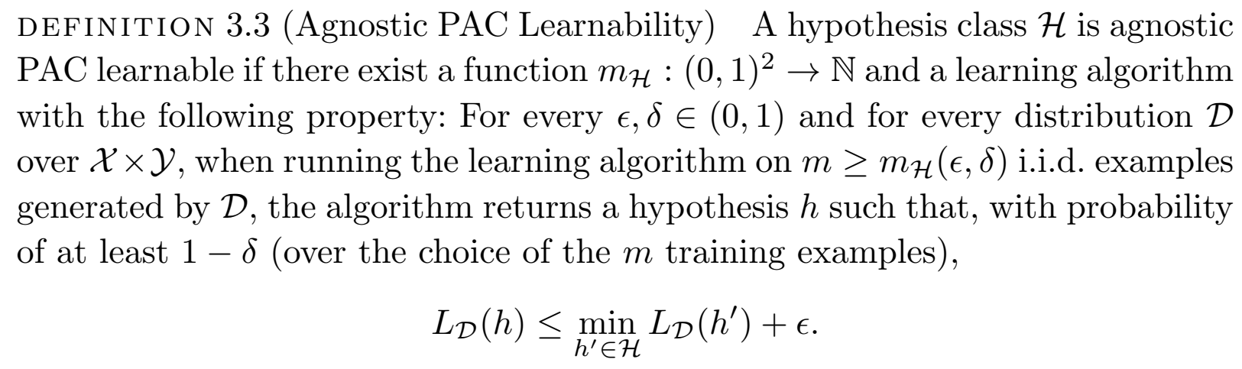
Notes:
Agnostic Case

Slide 21
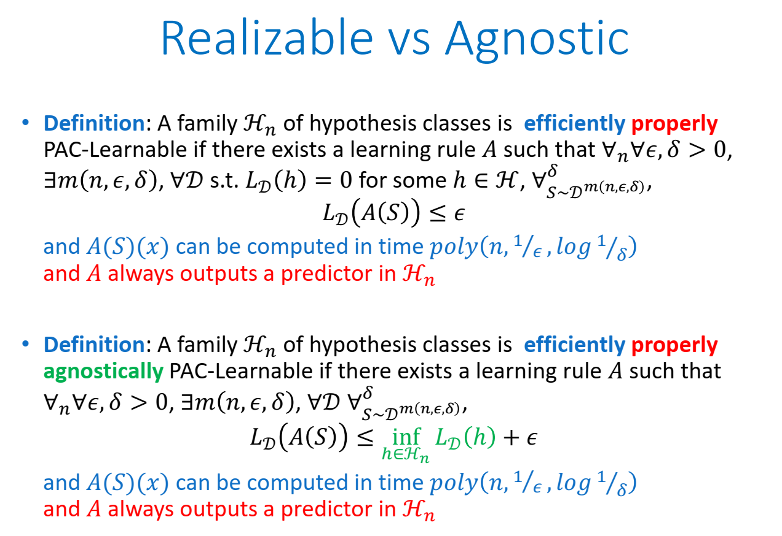

Slide 22
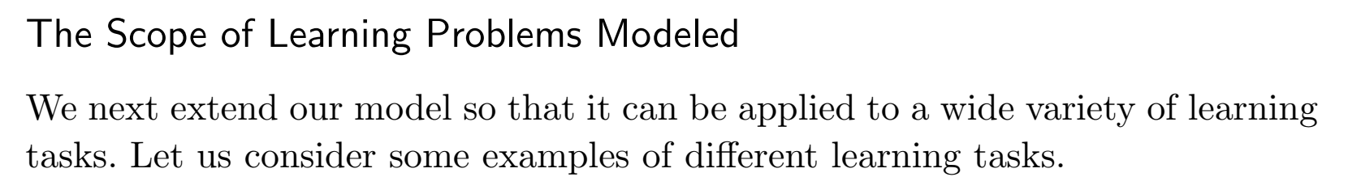
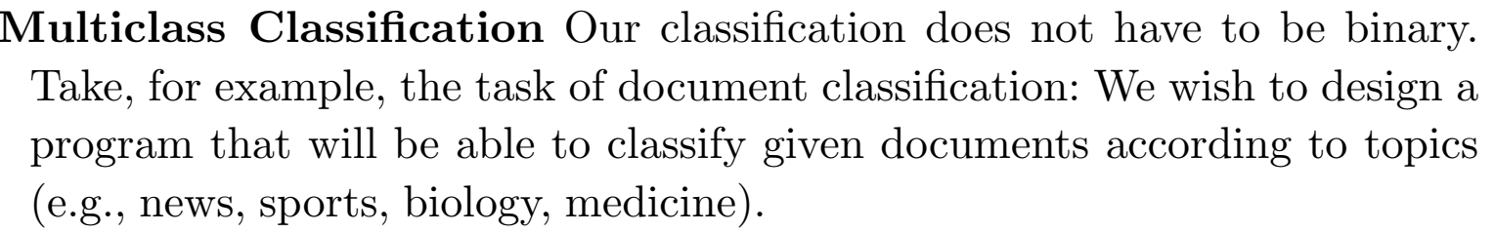
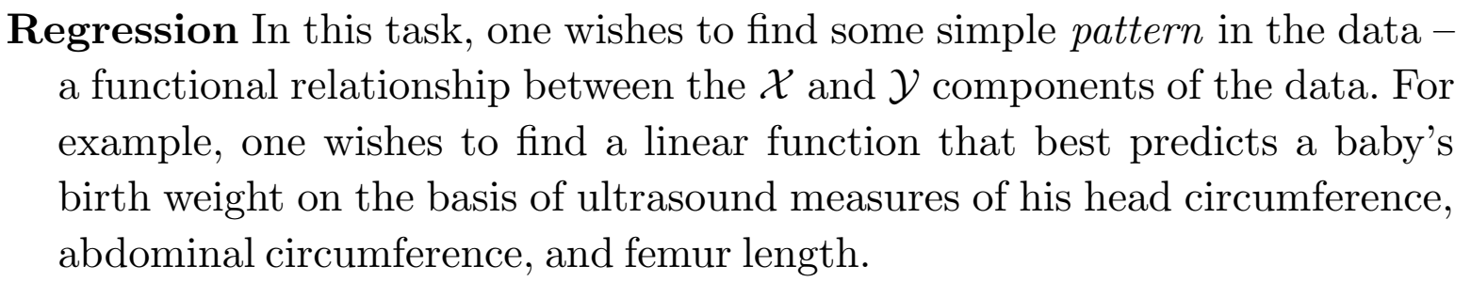

Slide 23
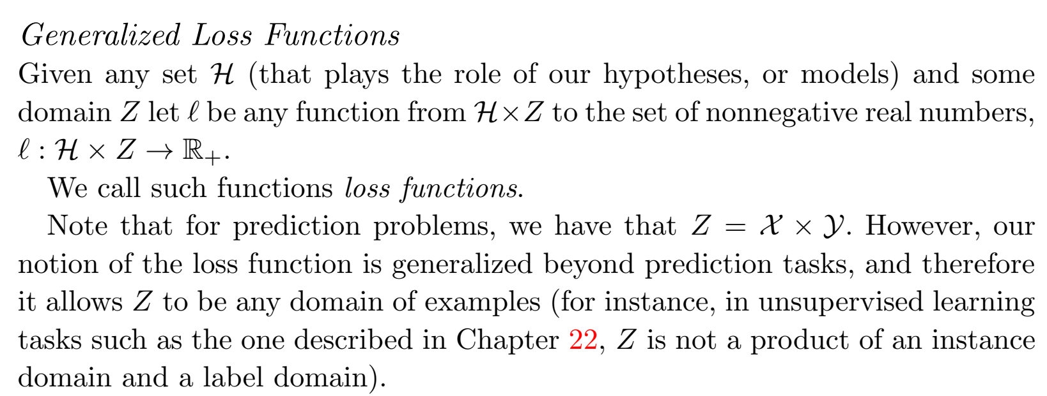

Slide 24
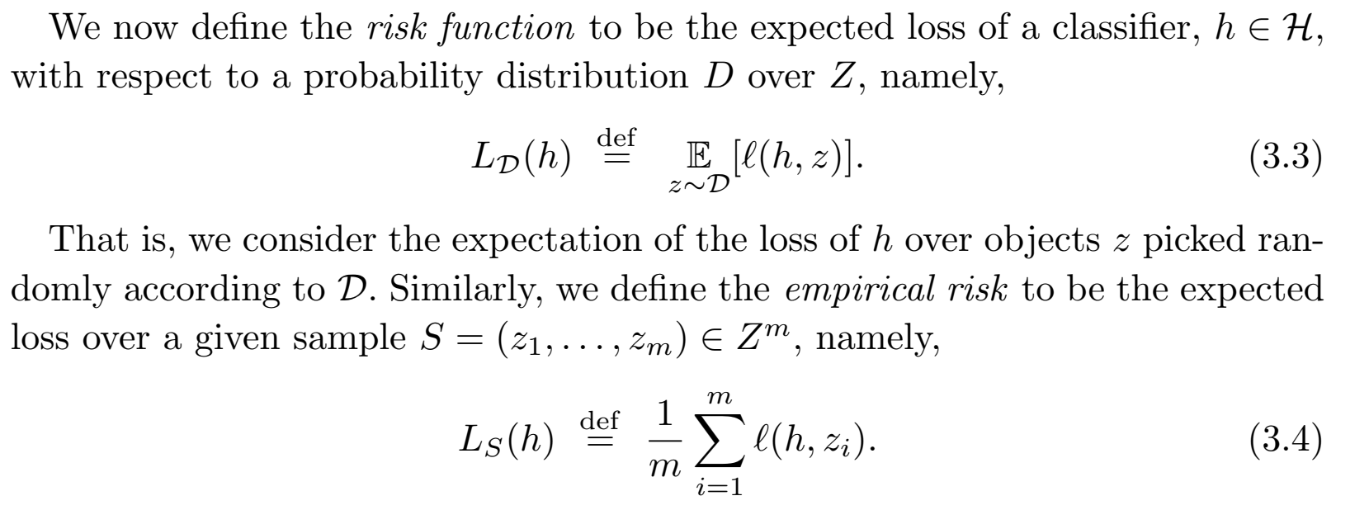

Slide 25
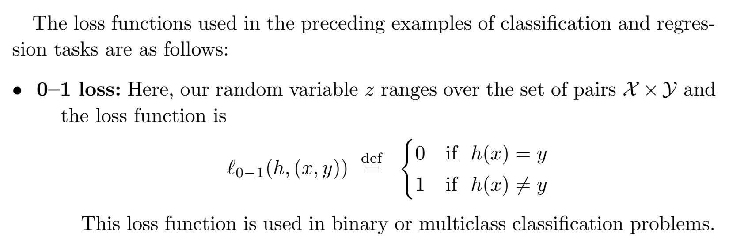

Slide 26
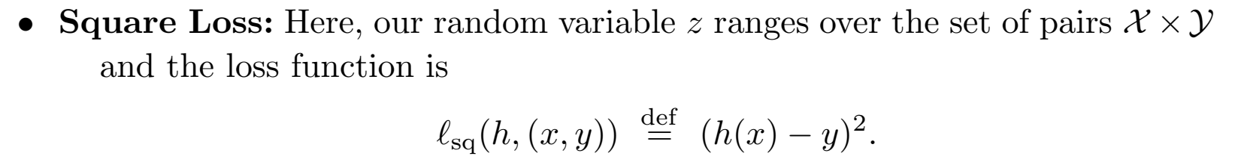

Slide 27
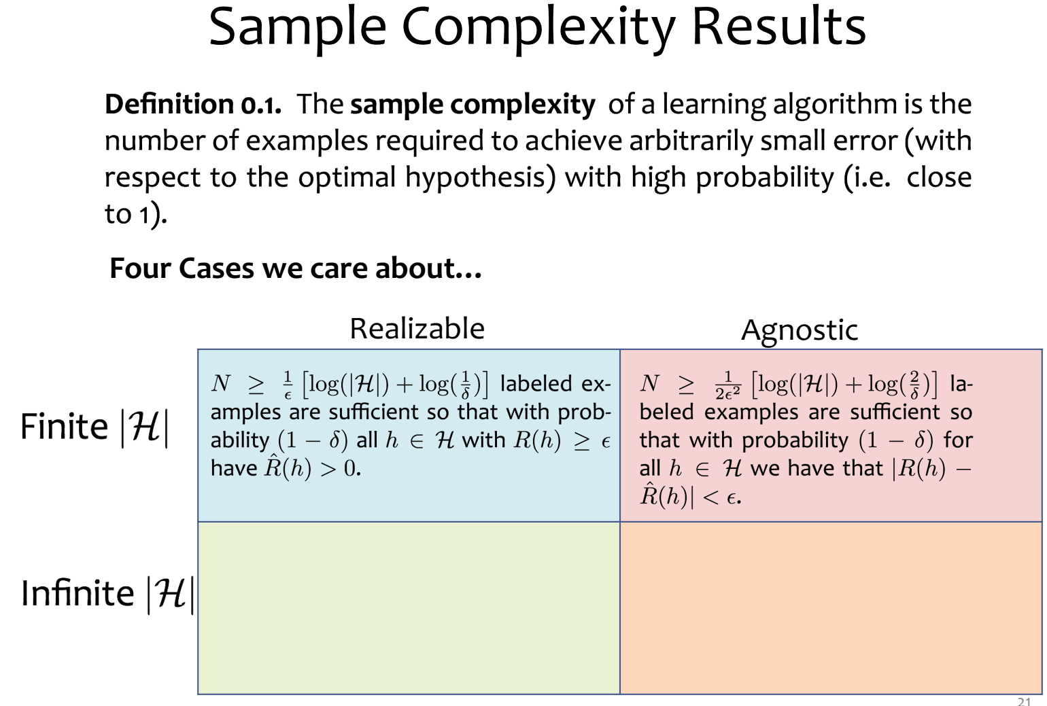
Sample Complexity

Slide 28
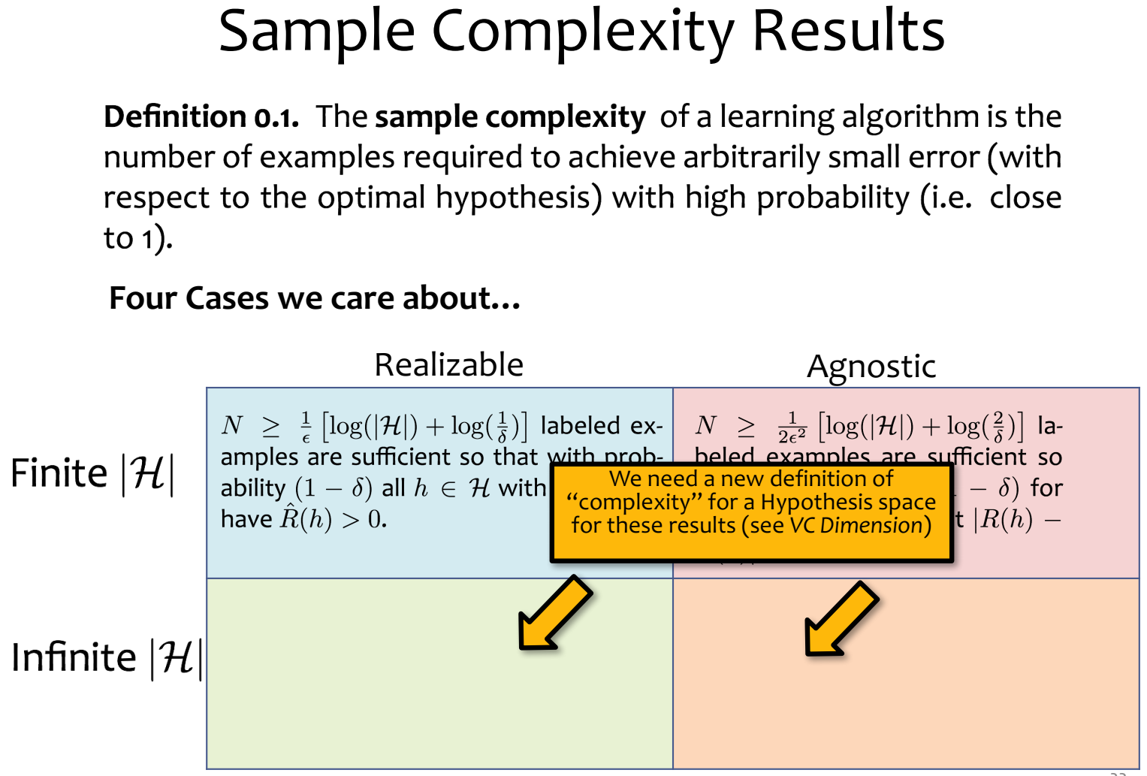

Slide 29
